Slide 1
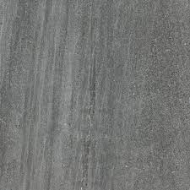


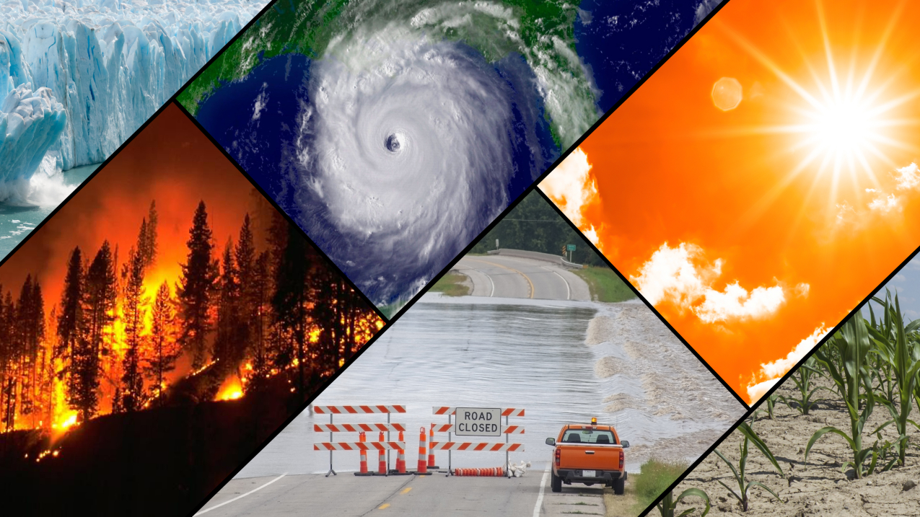
CSA0810-PYTHON PROGRAMMING Weather Prediction Using python
Guided By, Project By,
T. Vincent Gnanaraj M. SaiRam
(Course Faculty) (192210174)
Python Programming Computer Science & Engineering
SSE, SIMATS SSE, SIMATS

Slide 2
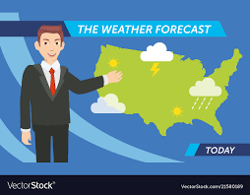
INTRODUCTION
Weather forecasting is the prediction of what the atmosphere will be like in a particular place
By using technology and scientific knowledge to make weather observations.
In other words, it's a way of predicting things like cloud cover, rain, snow, wind speed, and temperature before they happen

Slide 3
ABSTRACT
Weather forecasting is the attempt by meteorologists to predict the weather conditions at some future time and the weather conditions that may be expected. The climatic condition parameters are based on the temperature, wind, humidity, rainfall and size of data set. Here, the parameters temperature and Humidity only are considered for experimental analysis. The data is collected from the temperature and humidity sensor called DHT11 sensor, which helps in detecting the temperature and humidity values of a particular region or location. The raspberry pi is used for storing the collected data to the cloud, with the help of Ethernet shield for uploading the data online.
key words: Before happen,Technology,Gadgets

Slide 4

HARDWARE AND SOFTWARE REQUIREMENTS
I5 Processor intel core SDK:Python 3.11 version 6
Memory:16GB Editor:Idle,spyder,pycharm etc..
Moniter Packages:pylot,webcrawl,stats etc..
Internet connection Operating system:windows 10 or 11 64-bit
64 Bit OS

Slide 5
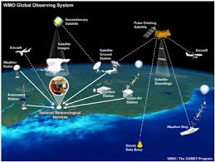
EXISTING SYSTEM
Weather forecasting entails predicting how the present state of the atmosphere will change. Present weather conditions are obtained by ground observations, observations from ships, observation from aircraft, radio sounds, doppler radar and satellites.

Slide 6
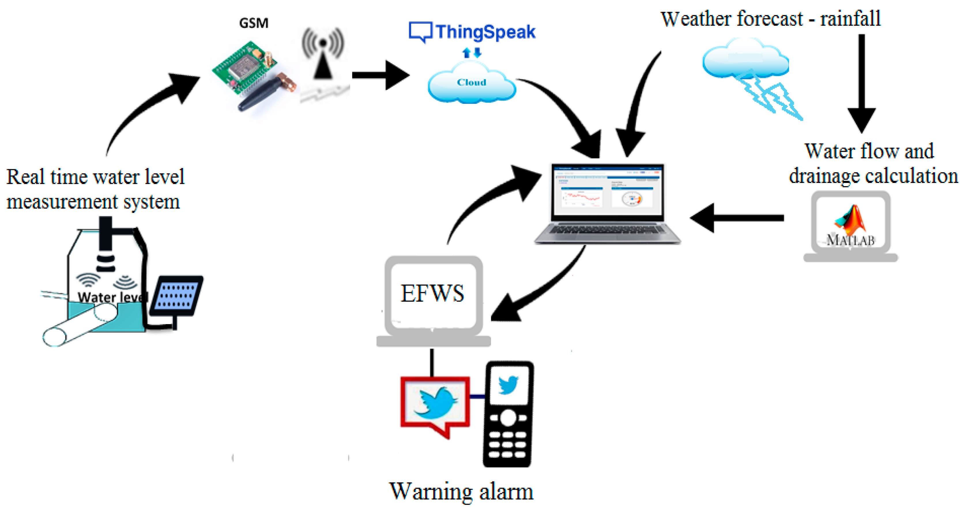
PROPOSED SYSTEM
Weather forecasts are made by collecting quantitative data about the current state of the atmosphere at a given place and using scientific understanding of atmospheric processes to project how the atmosphere will change.

Slide 7
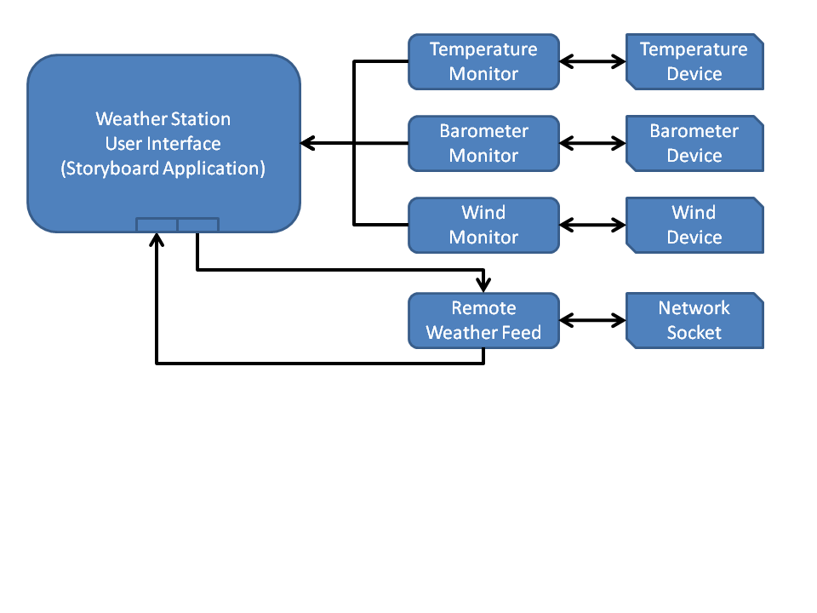
ARCHITECTURE

Slide 8
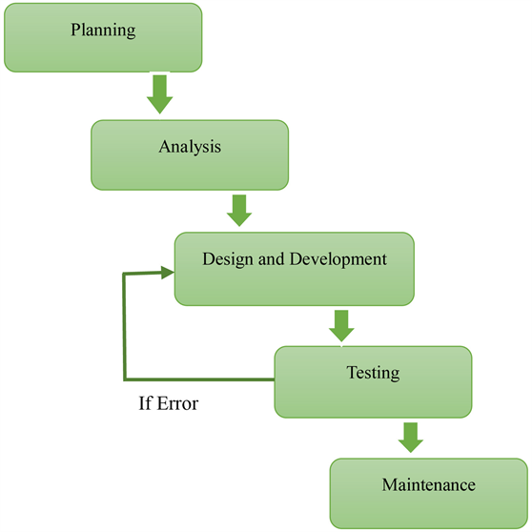
DESIGN
This is done by examining a large quantity of observation data including surface observations, satellite imagery, radar data, radiosonde data, upper-air data, wind profilers, aircraft observations, river gauges, and simply looking outside.This is done by examining a large quantity of observation data including surface observations, satellite imagery, radar data, radiosonde data, upper-air data, wind profilers, aircraft observations, river gauges, and simply looking outside.

Slide 9
CODING
import requests
print("\t\tWelcome to the Weather Forecaster!\n\n")
print("Just Enter the City you want the weather report for and click on the button! It's that simple!\n\n")
city_name = input("Enter the name of the City : ")
print("\n\n")
# Function to Generate Report
def Gen_report(C):
url = 'https://wttr.in/{}'.format(C)
try:
data = requests.get(url)
T = data.text
except:
T = "Error Occurred"
print(T)
Gen_report(city_name)

Slide 10
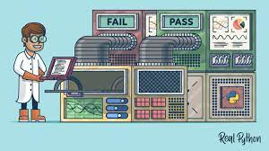
TESTING
Testing will identify defects, reduce flaws, and increase the overall quality of the system
Everyone can make mistakes, so testing is necessary because it helps us identify bugs or errors early
They can be fixed before the application is delivered to the client.
Hypothesis testing used for any predictions

Slide 11

IMPLEMENTATION
Weather forecasting is the application of science and technology to predict the conditions of the atmosphere for a given location and timeEnter the city name
There is a vast variety of end uses to weather forecasts
Weather forecasts are used by utility companies to estimate demand over the coming days

Slide 12
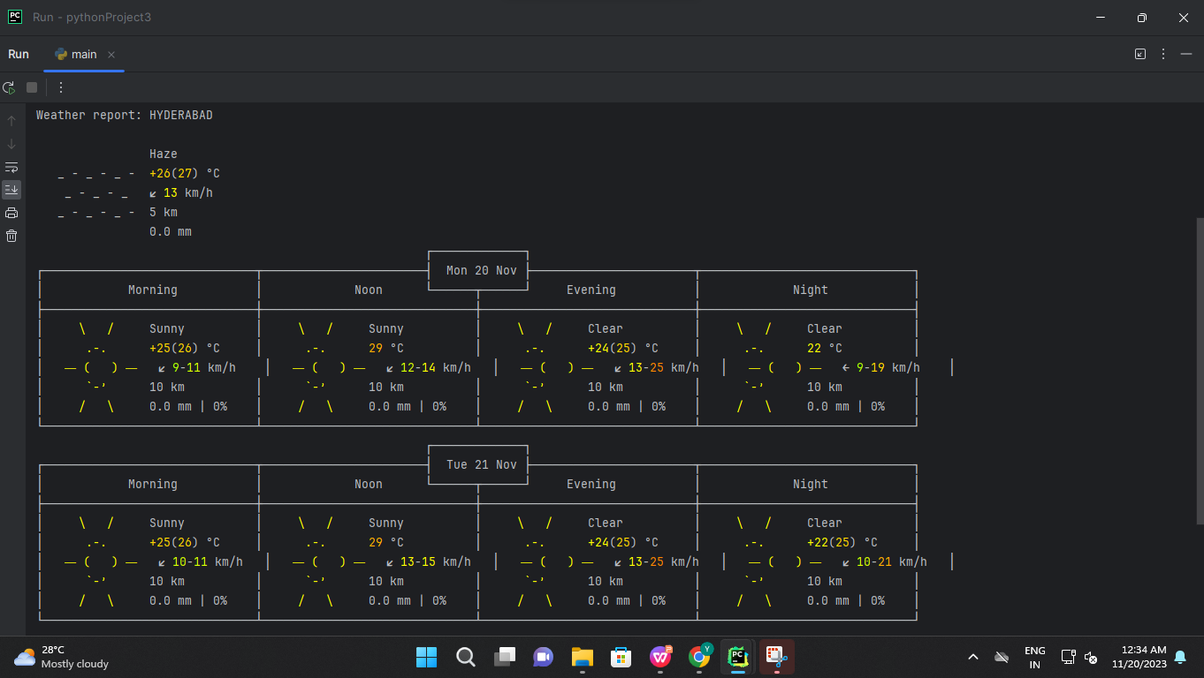
FINAL OUTPUT

Slide 13
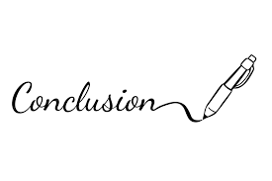
CONCLUSION
Weather forecasting is a complex and challengingscience that depends on the efficient interplay of weather observation, data analysis by meteorologistsand computers, and rapid communication systems.Meteorologists have achieved a very respectablelevel of skill for shortrangeweather forecasting.Further improvement is expected with densersurface and upper air observational networks, moreprecise numerical models of the atmosphere, largerand faster computers and more are to be realized.However, continued international cooperation isessential, for the atmosphere is a continuous fluidthat knows no political boundaries.

Slide 14
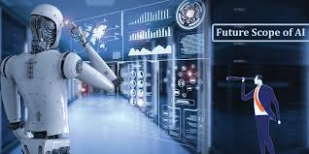
FUTURE SCOPE
AI Might Be the Future for WeatherForecasting.
The demand for weather and climate forecast information in support of critical decision-making has grown rapidly during the last decade and will grow even faster in the coming years.
Great advances have been made in the utilization of predictions in many areas of human activities.

Slide 15
REFRENCES
[1] Ahrens, C. Donald (2008). Essentials of meteorology: an invitation to the atmosphere. Cengage Learning. p. 244. ISBN 978-0-495-11558-8.
[2] Weather Doctor. "Applying The Barometer To Weather Watching". Retrieved May 25, 2008.
[3] Dennis Eskow (March 1983). "Make Your Own Weather Forecasts". Popular Mechanics. Vol. 159, no. 3. p. 148. Retrieved April 2, 2011.
[4] Mark Moore (March 25, 2009). "Field Forecasting – A Short Summary". Retrieved February 15, 2012.
[5] Glossary of Meteorology Retrieved May 26, 2015.
THANKYOU....

